Slide 1
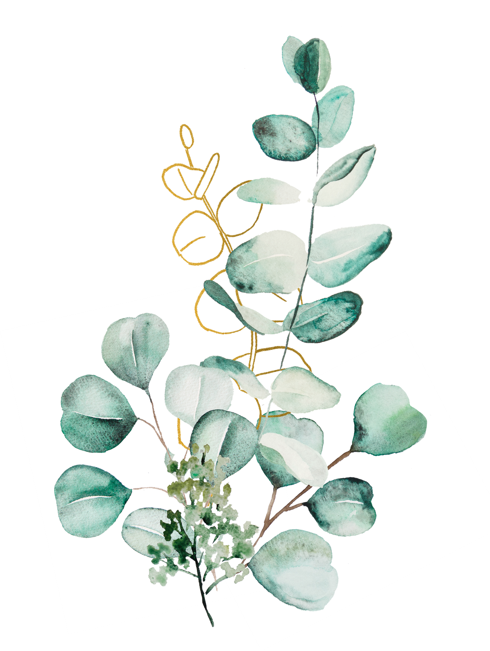
Welcome to Hawthorns Class!

Slide 2

School Uniform
​
  Burgundy sweatshirts, or cardigans with the Great Horwood School logo (compulsory) ​
  Grey trousers or shorts ​
  Grey skirt or pinafore dress ​
  White shirt or blouse with collar or polo shirt (with or without logo) ​
  Royal blue checked (Gingham) dresses can be worn in the summer
  Matching plain white, grey or black socks
  Plain grey tights ​
  Black school shoes​
  Hair to be tied back. Hair accessories should be plain navy or burgundy​
  No nail varnish​
A simple watch can be worn- no smart watches!​
  Small stud earrings can be worn but these must be removed on school days.​
  No friendship bracelets ​
  Plain black trainers will be required in school every day to change into at break and lunchtimes and for PE or other outdoor lessons specified by the class teacher.​
​

Slide 3

In KS2 children are required to bring in their own resources. These need to be a in small and simple pencil case which will be on their tables throughout the day. ​
​
  Black handwriting or roller ball pen (not a biro)​
  Blue handwriting pen (for editing)​
  Coloured pens for SPaG (these need to be different to your handwriting pens but not highlighters or whiteboard pens!)
  Pencils, sharpener and rubber​
  Ruler with millimetres​
  Scissors​
  Coloured pencils​
  Glue stick​
  Whiteboard pen (at least one!)​
  Small and simple pencil Case​
  Reading record ​
​
As Key Stage Two children, you must be responsible for your own belongings and learning. If you have run out of something in your pencil case then make sure you let someone at home know so that they can sort this for you! Please remember, handwriting pens are available to purchase from the office for 50p.
All personal items must be clearly labelled. Please ensure this is checked regularly!

Slide 4


PE and PE Kit
​
​
Please ensure that children have their PE kits in school everyday as sometimes PE days may change at short notice, or they may have extra curricular activities which require them to get changed.​
PE Kit must consist of:​
​
Royal blue polo shirt with Great Horwood School logo ​
Shadow stripe navy shorts ​
Black trainers for outdoor activities​
Navy tracksuits for colder months ​
Tights are not permitted to be worn for PE so a pair of socks will be required​
​
PE Days can be changeable, so we ask that children have their kit in school everyday!​
​
All personal items must be clearly labelled. Please ensure this is checked regularly!

Slide 5
Home Learning at Great Horwood
​
  Reading records- reading daily for 15 minutes either alone or to an adult. Parents to question once a week. Parents to sign daily, only to be handed in one day a week (Monday). If children read every day in the week (Monday-Monday) you will be rewarded with a ClassDojo point. An additional Dojo point will be awarded for reading over the weekend. ​
  Homework handed out on Friday and comes back on a Wednesday (Alternate English and Maths)- Children will have homework books to complete and return their work in weekly. Please note if not in this book, it will not be marked. If books are lost, children must pay £1 to replace these. If homework is not handed in, children will have to attend homework club on a Thursday lunchtime to complete this. ​
  TT Rockstars 30 mins a minimum at home a week​
  Daily reading (reading records)​
  Spelling (between 10 and 12 a week to be tested on a Friday morning. These will be handed out with homework on a Friday ready for the following week).

Slide 6

What needs to be in school each day?
​
  Named water bottle containing tap water- not squash or juice​
  Piece of fruit or veg for snack time (children are not allowed other snacks during this time)​
  Named coat/waterproof jacket​
  Named lunch box (if not school dinners)​
  Change of shoes for break and lunch times (PE trainers are fine)​
  PE kit in school everyday​
  A small bag for belongings (ideally a drawstring bag rather than a rucksack due to lack of space)

Slide 7
Healthy Lunchboxes
​Fruit​
Yoghurt​
Wrap/sandwich/pitta/crackers ​
A small treat/biscuit or crisps​
Children may have a drink of squash/smoothie/fruit juice in their lunch box, but this must not replace their water bottle. ​
No sweets!​
Reminder of no nuts- that includes Nutella ​
We strongly encourage a healthy lunchbox. Please remember that children need to have healthy, filling items in their lunchboxes to sustain them for the day. Children must have a water bottle in school everyday; it is so important that children remain hydrated.
​
  Named water bottle containing tap water- not squash or juice​
  Piece of fruit or veg for snack time (children are not allowed other snacks during this time)​
  Named coat/waterproof jacket​
  Named lunch box (if not school dinners)​
  Change of shoes for break and lunch times (PE trainers are fine)​
  PE kit in school everyday​
  A small bag for belongings (ideally a drawstring bag rather than a rucksack due to lack of space)

Slide 8

The School Day and Other Reminders
​
The school gates open at 8:35am and close at 8:45am.​
If you are late once the gate is closed, you will need to come in and sign your child/children in. if this is past 9am this is unauthorised unless informed beforehand.​
If your child is absent, please call the school office on 01296 712622 to inform us of their absence by 9:30am.​
Lunch is at 12:15-1:15pm​
The end of the school day is at 3:15pm, if your child can walk home alone, please ensure the school office have been made aware of your consent for this. ​
​
​
Reminders:​
  Please do not forget to book your school dinners on Parent Pay- anything for September (first week back) must be ordered before we break up for the summer.​
​

Slide 9


For anything SEN related, please email Mrs Dumbarton on senco@ghw.odbst.org
If you have any questions please feel free to contact us on hawthorns@ghw.odbst.org

