Slide 1
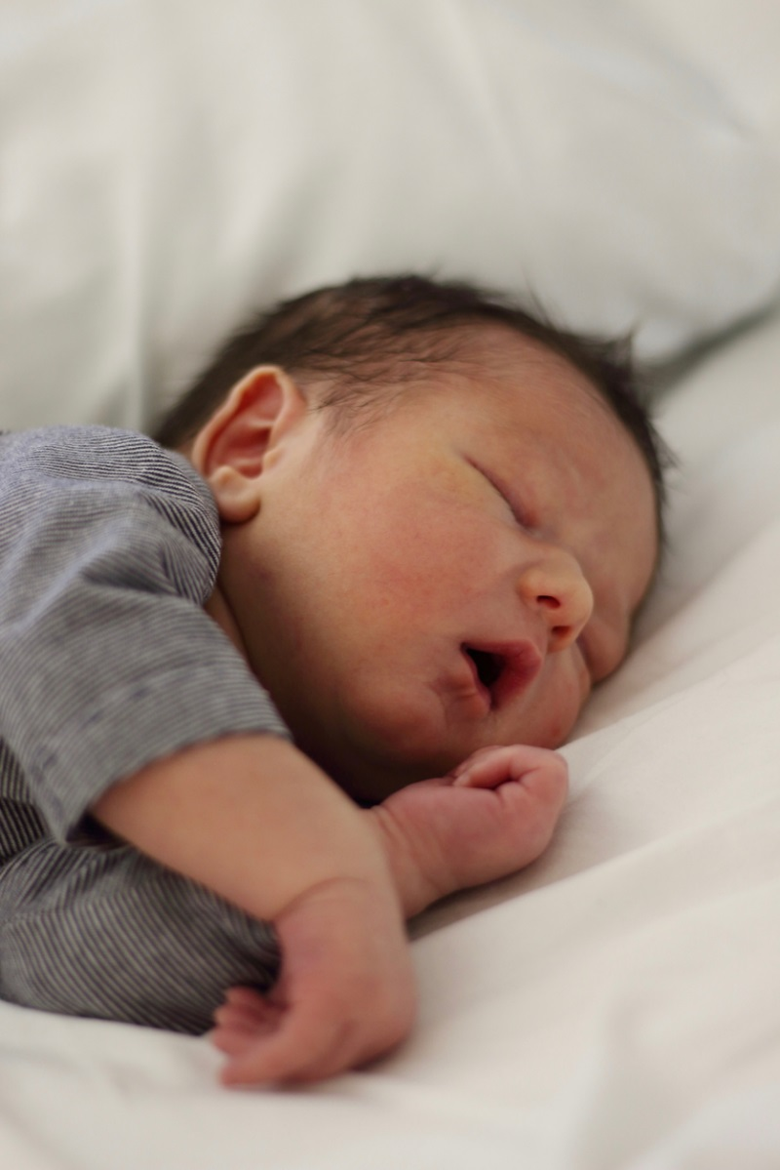
baby

Slide 2
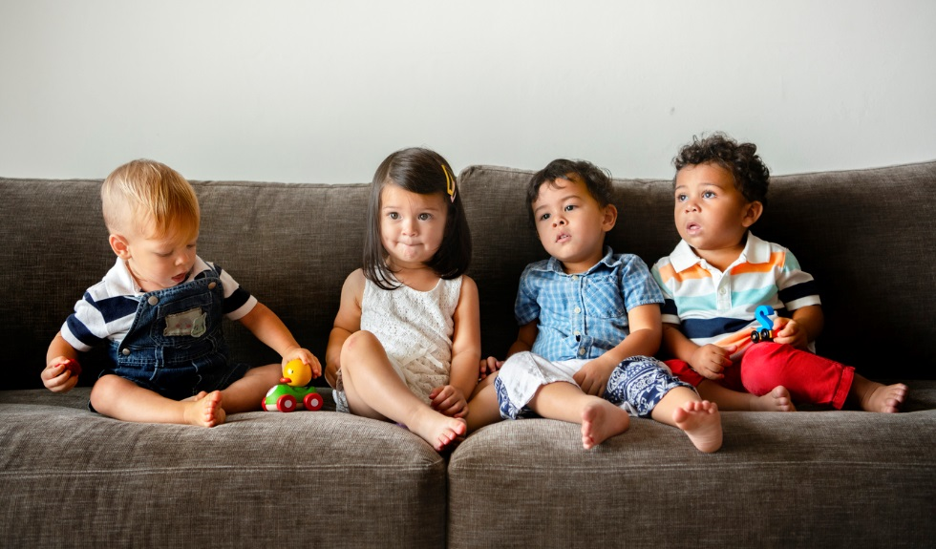
toddler

Slide 3

child

Slide 4

teenager

Slide 5

adult

Slide 6
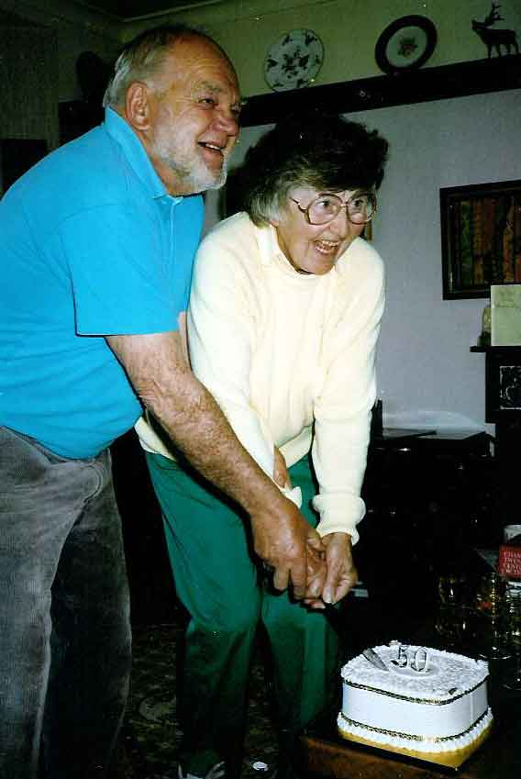
elder

Slide 7





6.
2.
1.
3.
5.
4.

