Slide 1
1. Between the ages of 8 and 16 the human body changes a lot both inside and out. This is called puberty
2. Chemicals called hormones make the changes happen. We all change at different times and in different ways because we are all unique
3. People get more hair on their bodies including facial hair, armpit hair and hair around the private parts

Slide 2
1. Between the ages of 8 and 16 the human body changes a lot both inside and out. This is called puberty | 8 - 16
2. Chemicals called hormones make the changes happen. We all change at different times and in different ways because we are all unique
3. People get more hair on their bodies including facial hair, armpit hair and hair around the private parts

Slide 3

1. Between the ages of 8 and 16 the human body changes a lot both inside and out. This is called puberty | 8 - 16
2. Chemicals called hormones make the changes happen. We all change at different times and in different ways because we are all unique
3. People get more hair on their bodies including facial hair, armpit hair and hair around the private parts

Slide 4
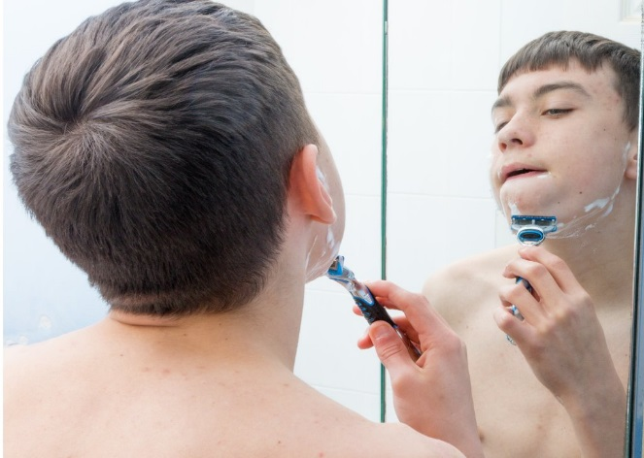
1. Between the ages of 8 and 16 the human body changes a lot both inside and out. This is called puberty | 8 - 16
2. Chemicals called hormones make the changes happen. We all change at different times and in different ways because we are all unique
3. People get more hair on their bodies including facial hair, armpit hair and hair around the private parts

Slide 5
4. Armpits start to smell, and people might choose to use a deodorant
5. The skin becomes oilier and teenagers may get spots
6. Teenagers’ moods can go up and down. They can get strong feelings for others and may get a boyfriend or girlfriend

Slide 6
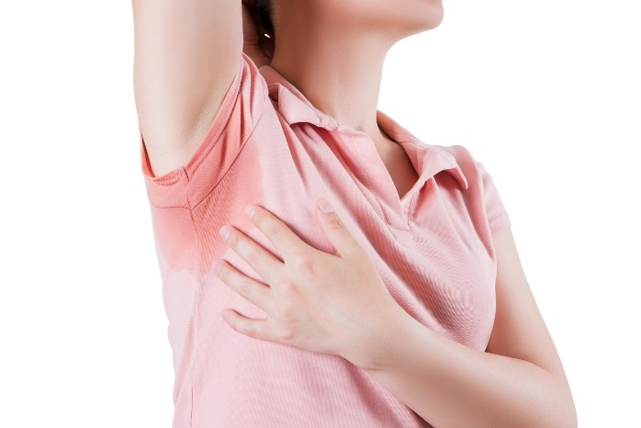
4. Armpits start to smell, and people might choose to use a deodorant
5. The skin becomes oilier and teenagers may get spots
6. Teenagers’ moods can go up and down. They can get strong feelings for others and may get a boyfriend or girlfriend

Slide 7
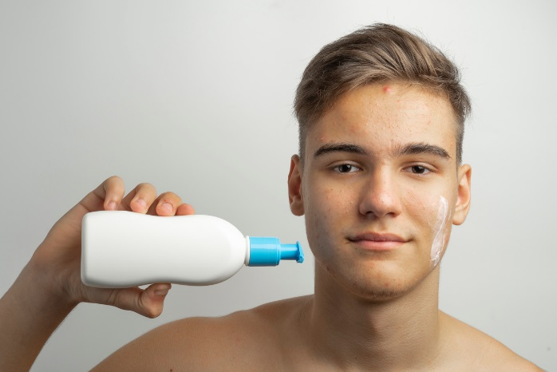
4. Armpits start to smell, and people might choose to use a deodorant
5. The skin becomes oilier and teenagers may get spots
6. Teenagers’ moods can go up and down. They can get strong feelings for others and may get a boyfriend or girlfriend

Slide 8

4. Armpits start to smell, and people might choose to use a deodorant
5. The skin becomes oilier and teenagers may get spots
6. Teenagers’ moods can go up and down. They can get strong feelings for others and may get a boyfriend or girlfriend

Slide 9
7. Females develop breasts. They start to have their period, a tiny egg is released each month and there is a small amount of bleeding.
8. Males might have a wet dream. When they wake up they might have a sticky patch on their pyjamas. It is a sign that they have started to produce sperm.

Slide 10
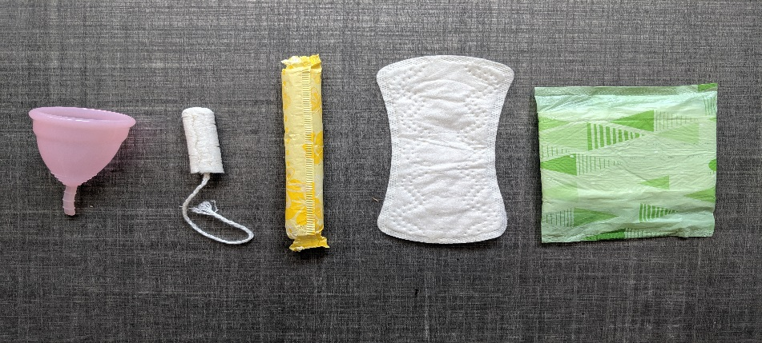
7. Females develop breasts. They start to have their period, a tiny egg is released each month and there is a small amount of bleeding.
8. Males might have a wet dream. When they wake up they might have a sticky patch on their pyjamas. It is a sign that they have started to produce sperm.

Slide 11
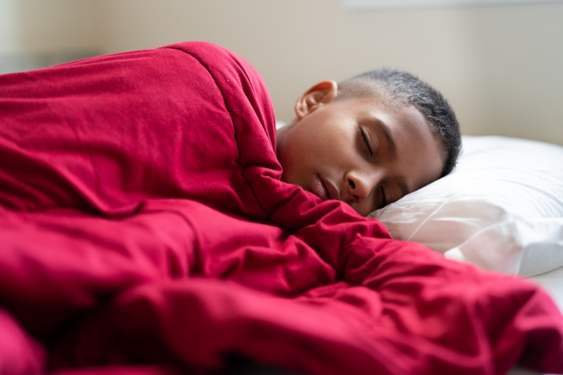
7. Females develop breasts. They start to have their period, a tiny egg is released each month and there is a small amount of bleeding.
8. Males might have a wet dream. When they wake up they might have a sticky patch on their pyjamas. It is a sign that they have started to produce sperm.

