Slide 1
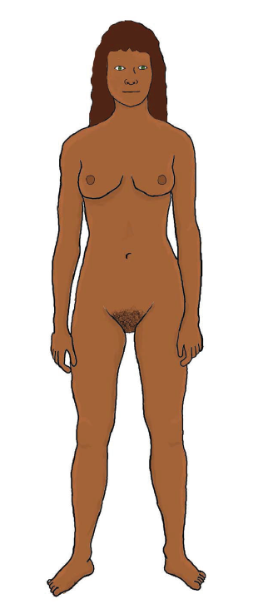

Slide 2
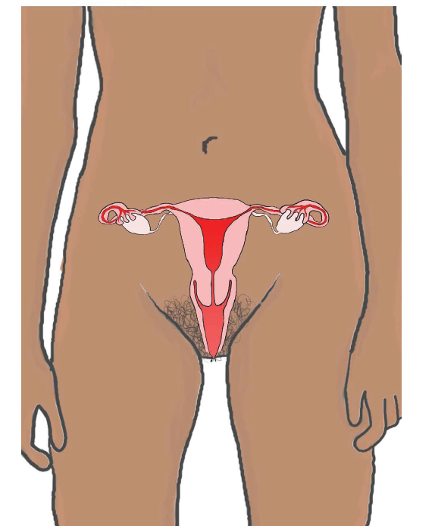
Uterus
Ovaries
Vagina

Slide 3
Uterus
The uterus is sometimes called the womb. If a female chooses to have a baby the uterus is where the baby develops
Ovaries
There are two ovaries – they are connected to the uterus by the fallopian tubes. The ovaries contain the female sex cells which are called eggs or ova.
Vagina
The vagina is the passageway that connects the uterus to the outside of the body.

Slide 4
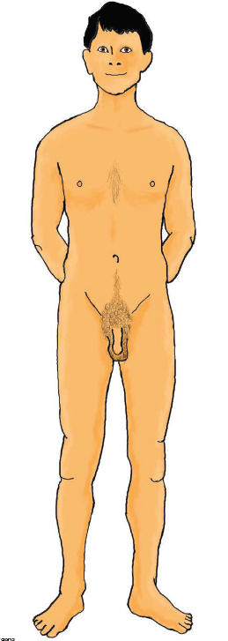

Slide 5
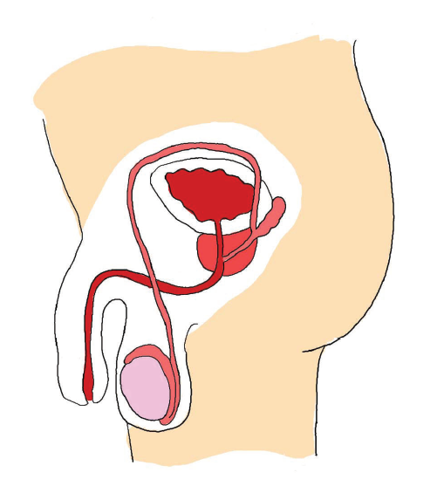
Penis
Testicles

Slide 6
Penis
The penis usually is soft and hangs down. Sometimes the penis becomes hard and stands out from the body. This is called an erection.
Testicles
There are two testicles behind the penis – they are held in a sac of skin called the scrotum. During puberty the testicles start to produce the male sex cells which are called sperm.

