Slide 1
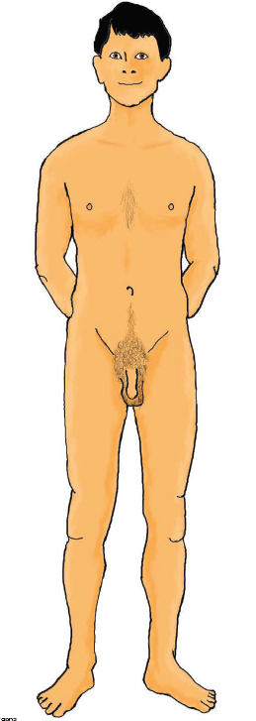

What changes happen to the Male reproductive system during puberty?

Slide 2
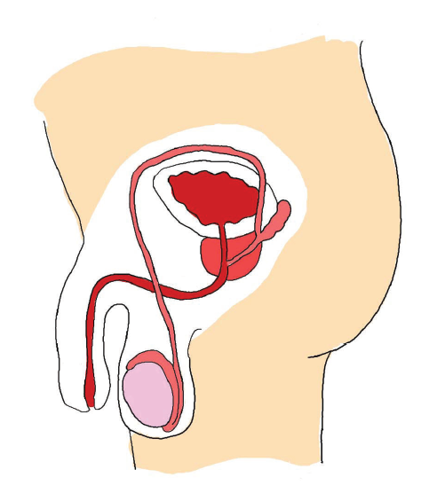
Penis
During puberty the penis gradually grows larger.
Testicles
During puberty the testicles grow bigger and hang a bit lower. The testicles are covered by a sac of skin called the scrotum. The testicles produce sperm.
Foreskin
This is the loose skin that covers the end of the penis. Some males have this removed by a doctor when the are babies, often for religious or cultural reasons.

Slide 3
Semen
Is a white sticky liquid. Sperm mixes with this liquid before it comes out of the end of the penis. This is called ejaculation. Each ejaculation of semen contains millions of tiny sperm
Sperm
The sperm are the male sex cells. During puberty the testicles start to produce sperm every day

Slide 4
Erection
This is where the penis becomes hard and sticks out. Erections can happen quite often. Erections are a normal part of growing up.
Ejaculation
One or two teaspoons of semen come out of the end of the penis. Ejaculation doesn’t happen every time a boy has an erection. Some males are asleep when they first ejaculate. This is called a wet dream.

