Slide 1
EYFS
Reading & Writing
Workshop
October 2024

Slide 2
What are we going to cover?
What is Phonics?
What is Little Wandle Letters and Sounds
How do we teach phonics
Getting children ready to read
Supporting your child with reading at home
Pronouncing pure sounds
Using the letter formations and spelling sequence to support writing at home
Phonics Screening check

Slide 3
What is Phonics?
A method of teaching beginners to read and pronounce words by learning to associate letters or letter groups with the sounds they represent.
There are 44 main sounds in the English language. Each phoneme (sound) is represented by a grapheme (the written representation of a sound).

Slide 4
Some vocabulary that your children might use!
Phoneme: the smallest single identifiable sound in a word. eg in the word cat there are 3 phonemes c/a/t.
Grapheme: the written representation of a sound.
Digraph: two letters making one sound eg /sh/ in the word shop.
Trigraph: three letters making one sound eg /igh/ in the word night.
Split digraph: two vowel letters split by one or more consonants eg /a-e/ in the word cake.

Slide 5
What is Little Wandle Letters and Sounds?
Little Wandle Letters and Sounds is our chosen synthetic phonics programme. It teaches children to read by identifying the phonemes (smallest unit of sound) and graphemes (letter shape) within words and using these to read words.
Children experience the joy of books and language whilst rapidly acquiring the skills they need to become fluent, independent readers and writers.
Notes:
Interactive whiteboard g words
Speed sounds including g
Time for a rubbish picture
Handwriting
Geraldine
Build words (change first sound, change end sound, change middle sound, nonsense

Slide 6
We will share with you…
One fully decodable book that supports sounds previously taught will be pinged to you via the E Collins app. Please try and read this every day.
Sound patters to help with correct letter formation eg down the mouse over the ear over the ear
Homework – we don’t need this to come back to school.
Sound wallets: every Friday we will add 4 new graphemes to the sound wallet AND the harder to read words that we have learnt that week eg the.
No matter what scheme is used our aim is still the same…we want your children to learn to read and write!

Slide 7
How do we teach phonics?
Daily phonics sessions have started
Phonics throughout the day to review new phonemes and graphemes taught
Lots of opportunities for oral sound blending c/oa/t
Opportunities for writing – new graphemes, words and sentences

Slide 8
Supporting your child with reading at home:
Try and read a bedtime story every night
Reading to your child will improve their outcomes
We will only send home entirely decodable books
We only use pure sounds when decoding (no ‘uh’ after the sound)
We want them to practise reading their every day of the week working on these skills:
    Decoding
    Fluency
    Expression
    Comprehension

Slide 9
Supporting your child with reading at home:
Make sure that they are making sense of the text not just reading it as a process:
  Ask questions
  Predict what might happen on the next page or at the end
  Think of an alternative ending
Not all books are stories (fiction). We are learning that we can retrieve information from books and we call these information books (non fiction).
Your child will change their library book every Friday – this will not be decodable. Please try and remember to send the library book back to school before the Friday visit.

Slide 10
Harder to Read Words & Homework
Tricky words cannot be decoded by phonics.
They just have to be read on sight
  the, I, no, go, to
  he, she, we, me, my, said
  There is always a part of a tricky word that is not tricky.

Slide 11
The Early Learning Goal for Word Reading
Our evidence must be child initiated – your evidence counts!
Emerging
Children at the expected level will:
  Say a sound for each letter in the alphabet and at least 10 digraphs
  Read words consistent with their phonic knowledge by sound-blending
  Read aloud simple sentences and books that are consistent with their phonic knowledge, including some common exception words
Exceeding – THERE IS NO EXCEEDING LEVEL ANYMORE
Notes:
EXCEEDING: children can read phonically regular words of more than one syllable as well as many irregular but high frequency words. They use phonic, semantic (the meaning of the words or phrases) and syntactic (relates to the rules of language) knowledge to understand unfamiliar vocabulary. They can describe the main events in the simple stories that they have read.

Slide 12
The Early Learning Goal for Comprehension
Our evidence must be child initiated – your evidence counts!
Emerging
Children at the expected level will:
  Demonstrate understanding of what has been read to them by retelling stories and narratives using their own words and recently introduced vocabulary
  Anticipate – where appropriate – key events in stories
  Use and understand recently introduced vocabulary during discussions about stories, non-fiction, rhymes and poems and during role-play
Exceeding – THERE IS NO EXCEEDING LEVEL ANYMORE
Notes:
EXCEEDING: children can read phonically regular words of more than one syllable as well as many irregular but high frequency words. They use phonic, semantic (the meaning of the words or phrases) and syntactic (relates to the rules of language) knowledge to understand unfamiliar vocabulary. They can describe the main events in the simple stories that they have read.

Slide 13
Writing…
Notes:
New sound
Revise sounds so far learnt
Letter formation
Tricky words
Blending for reading
Chunking for writing – How many sounds can you hear in a word
LISTENING SKILLS
Phonicsplay
Mr Thorne & Geraldine
The order – initial pure sounds, then digraphs and trigraphs
Tricky words and tricky sounds
YPUR JOB TODAY IS…(preparation for Year 1 and a good link with parents

Slide 14
There are lots of processes involved.
As one process appears to have been mastered another may be forgotten.
Which stage is your child at?
Makes marks but doesn’t give a meaning
Gives meaning to marks
Uses recognisable letters in mark-making
Hears the initial sound in a word and represents it with ‘a letter’
Hears initial sounds in a word and represent it with the corresponding letter
Hears initial and end sounds in words and represents them with the corresponding letter
Hears more sounds in words – ‘segmenting for writing’ is the opposite of ‘blending for reading’

Slide 15
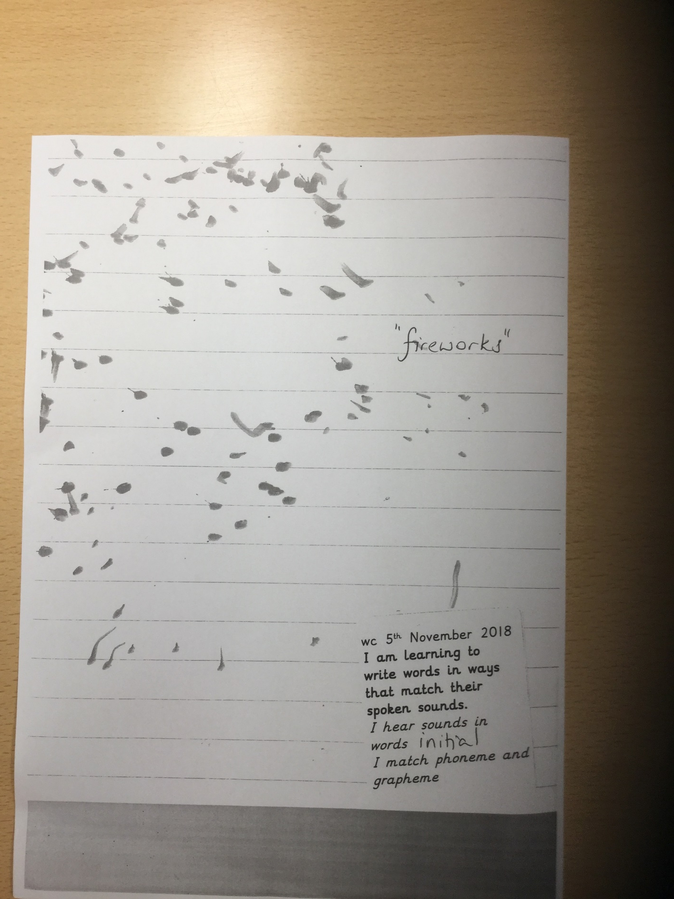
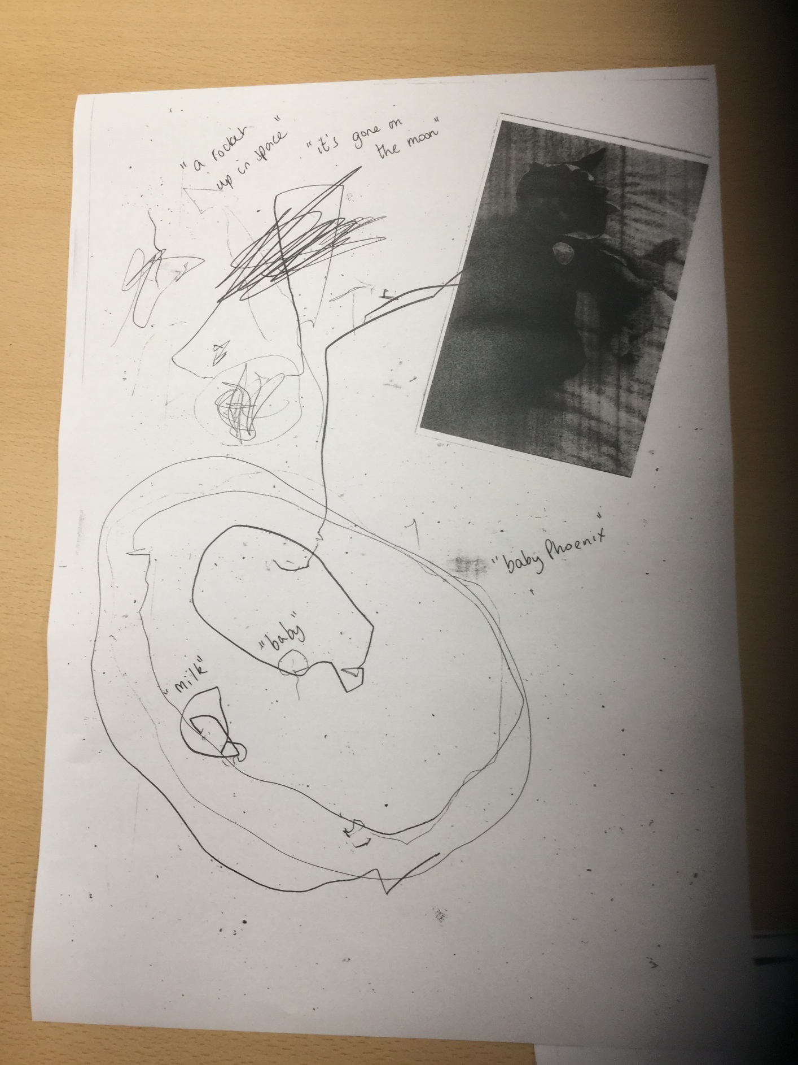

Slide 16
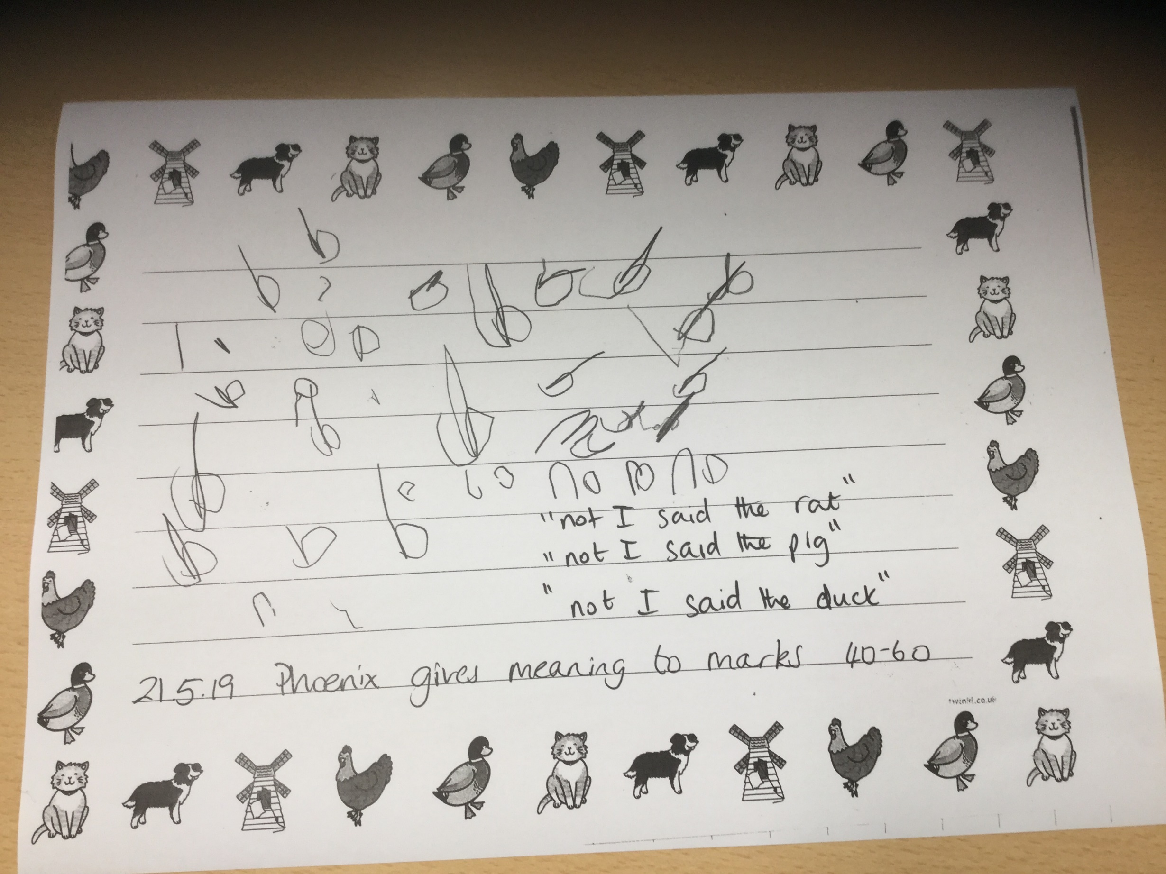

Slide 17
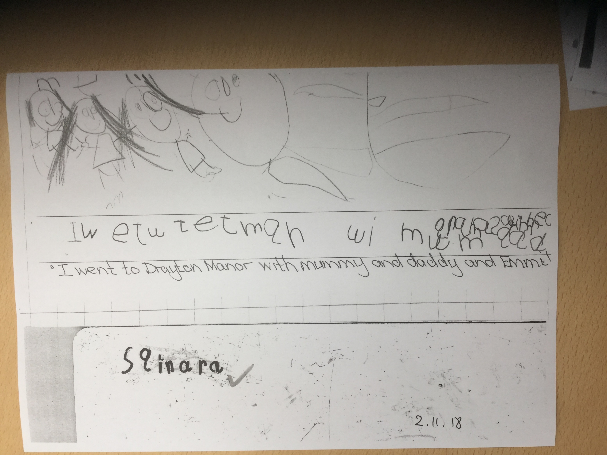

Slide 18
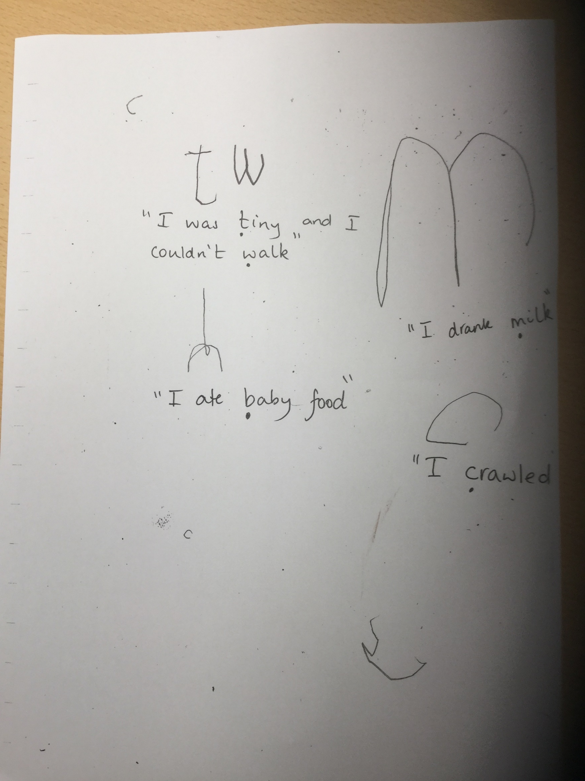

Slide 19
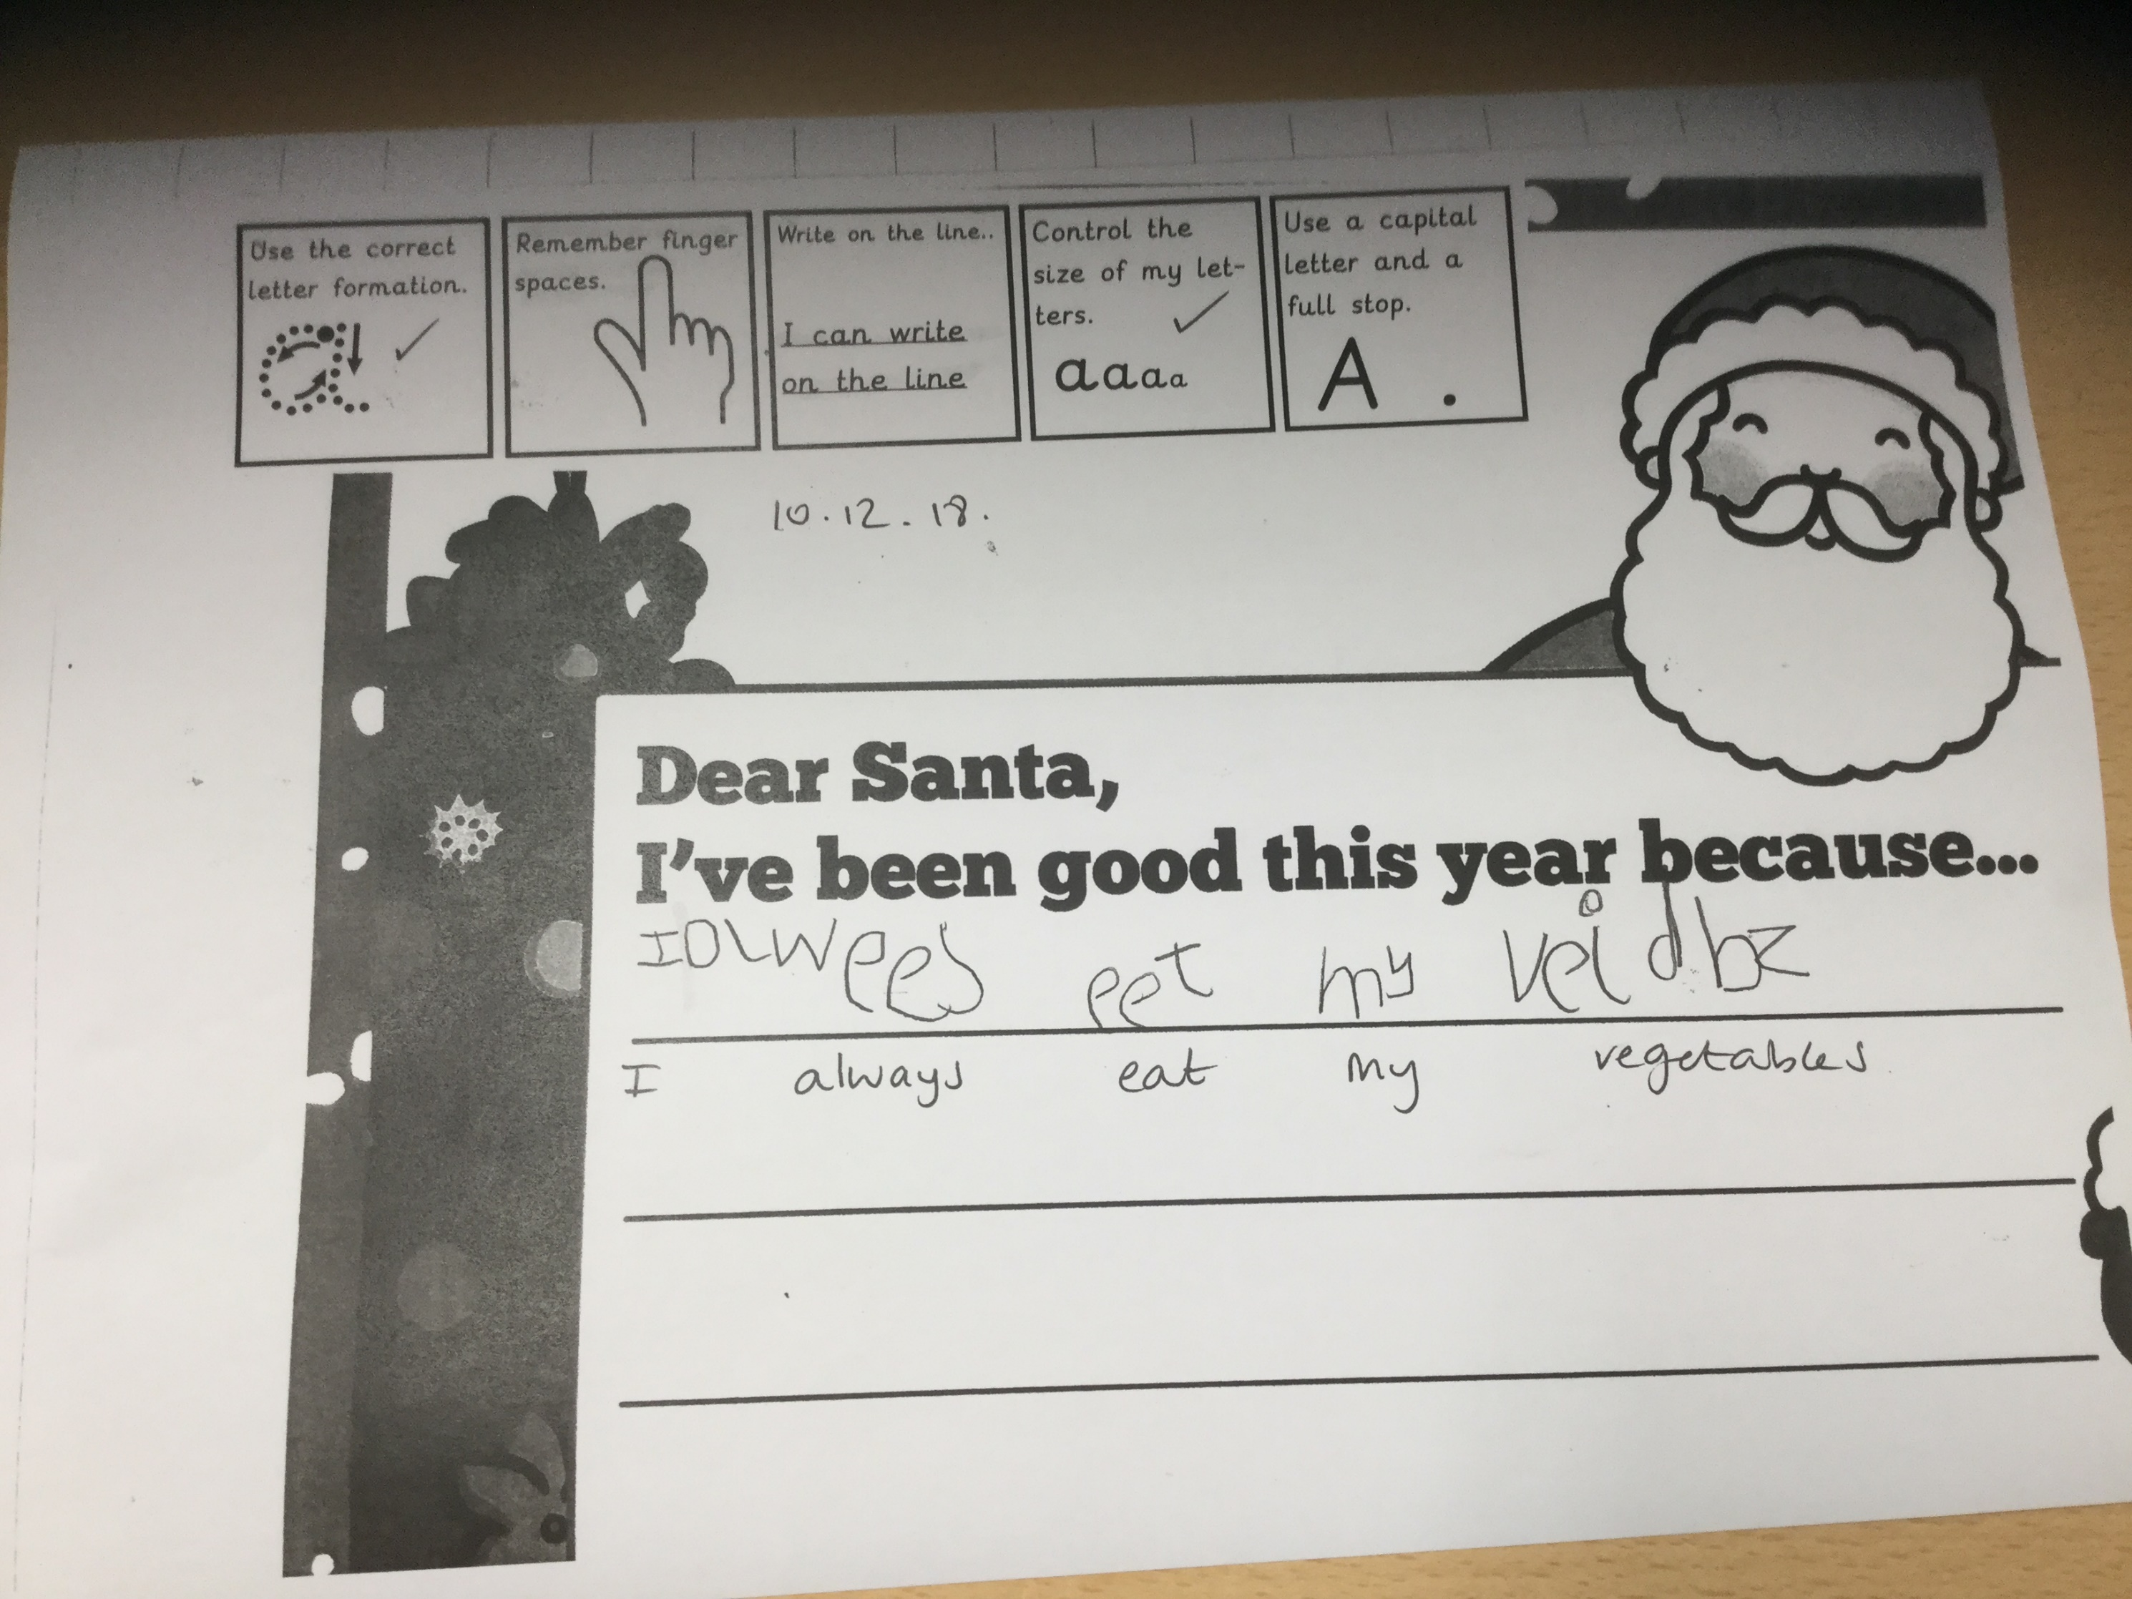

Slide 20
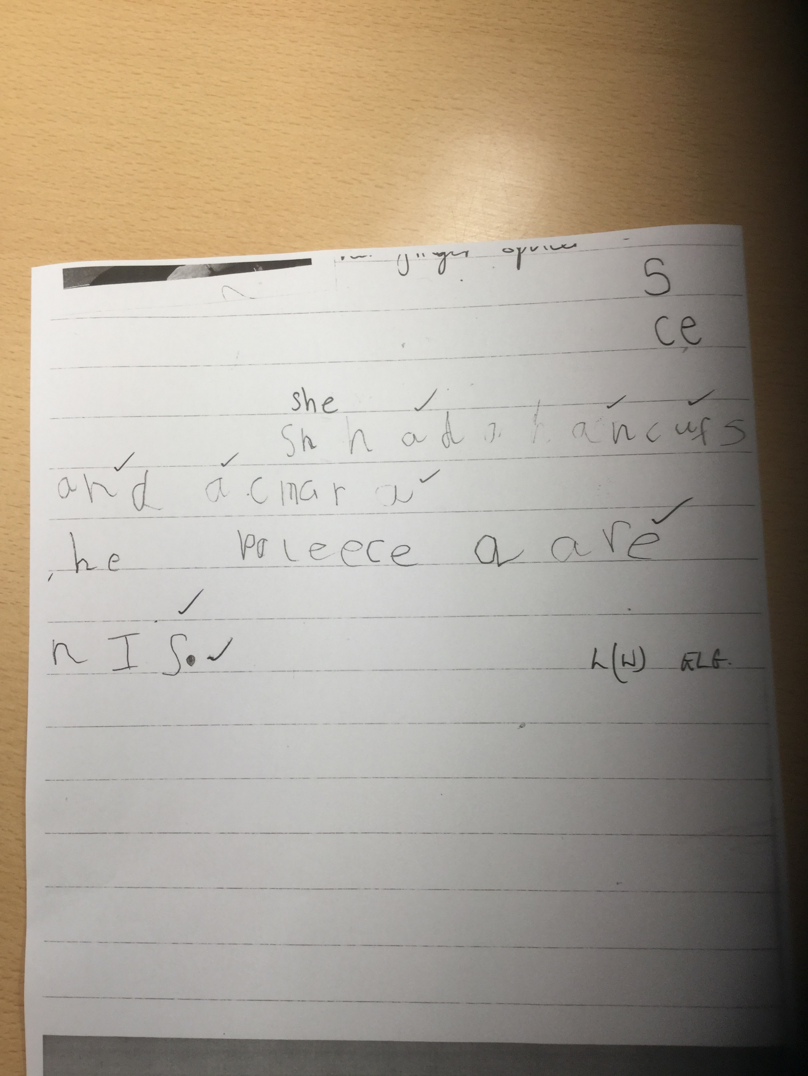

Slide 21
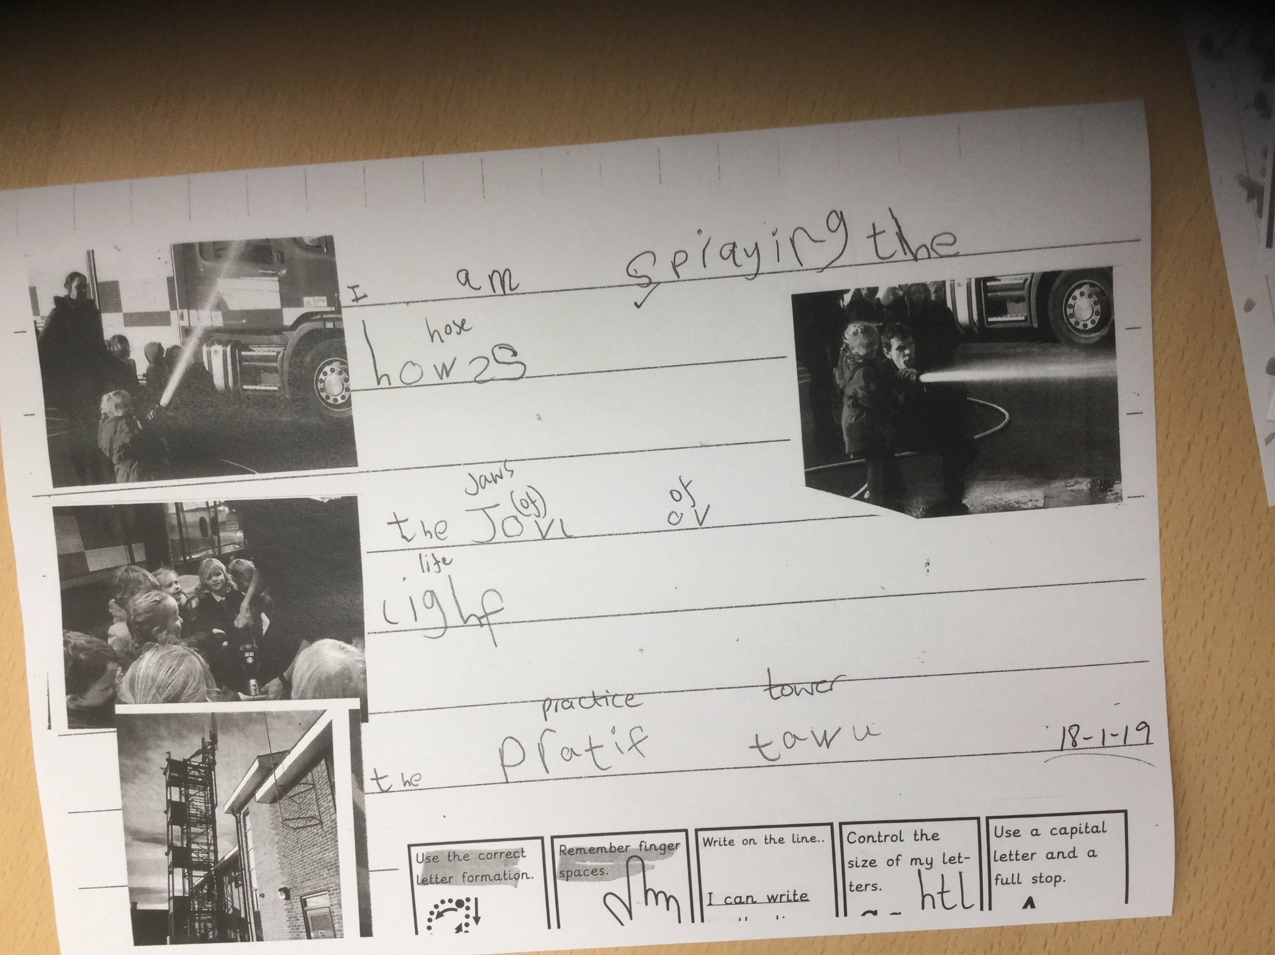

Slide 22
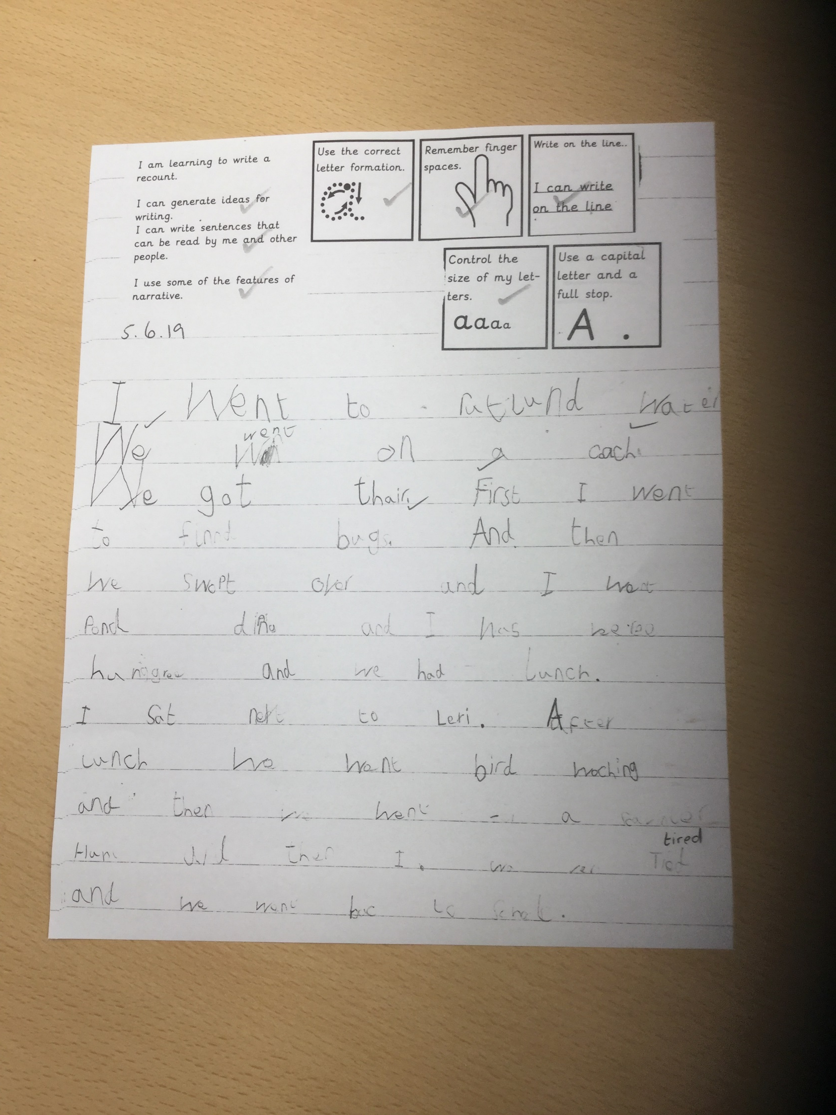

Slide 23
chunking the word – which letter shapes do I need?
But there’s more to writing…
A capital letter to show where my sentence begins
correct letter formation
writing on the line
A full stop to show where my sentence ends
,
!
“ “
?
tricky words
finger spaces
letter formation
It’s ever so hard!

Slide 24
The Early Learning Goal for Writing
Must be child initiated – your evidence counts!
Emerging
Children at the expected level will:
  Write recognisable letters, most of which are correctly formed
  Spell words by identifying sounds in them and representing the sounds with a letter or letters
  Write simple phrases and sentences that can be read by others
Exceeding – THERE IS NO EXCEEDING LEVEL ANYMORE
Notes:
EXCEEDING children can spell phonically regular words of more than one syllable as well as many irregular but high frequency words. They use key features of narrative in their own writing.

Slide 25
Things to remember:
Reading nonsense words is part of the national Phonics Screening test that your children will do in Year 1
Sound wallet with the sounds learnt so far. Keep it in the book bag so that we can add to it.
Make VC and CVC words (consonant-vowel-consonant)
Say the sound and your child finds the grapheme. Point to the grapheme and your child says the pure sound
Make nonsense words and say, “that’s nonsense!”
Change the initial sound and see how the word changes (repeat for middle and end sounds)
Play: ‘So off she went around the house to find something beginning with…’
Notes:
Remember to read REAL books at home. Enjoy stories – laugh!

Slide 26
Useful websites:
For parents | Letters and Sounds (littlewandlelettersandsounds.org.uk) follow the links to the parent pages
www.oxfordowl.co.uk loads of fun ideas and interactive books (many of which are free)
www.phonicsplay.co.uk interactive resources and information (some things are free)
www.bbc.co.uk follow links to story time on Cbeebies
www.mrthorne.com google search eg Geraldine learns b

Slide 27
Any other business
Little star vouchers
Maths Workshop on Monday 11th November, 2024 17:00-18:00

